Slide 1
PSYC19
Psychology of Self-Control
Lecture 9: Rethinking self-control

Slide 2
Reminder
Op-ed paper due Nov 23rd, 11:59pm)
  Submit on Quercus
Course Evaluations

Slide 3
Lecture 9 overview
The standard view of self-control
Rethinking how to assess self-control in the moment
Rethinking what it means to have high self-control
Rethinking what causes us to feel tired or depleted
BREAK TIME
Rethinking the effectiveness of self-control
Rethinking the definition of self-control

Slide 4
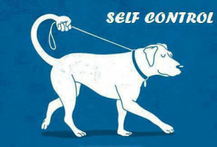
Self-control the standard view
Self-control assessment
  Sequential task paradigm, trait self-control (self-report), behavioural measures of cognitive control
Trait self-control
  People high in self-control control themselves more
Self-control and fatigue
  Exerting effortful control leads to feelings of fatigue/depletion

Slide 5
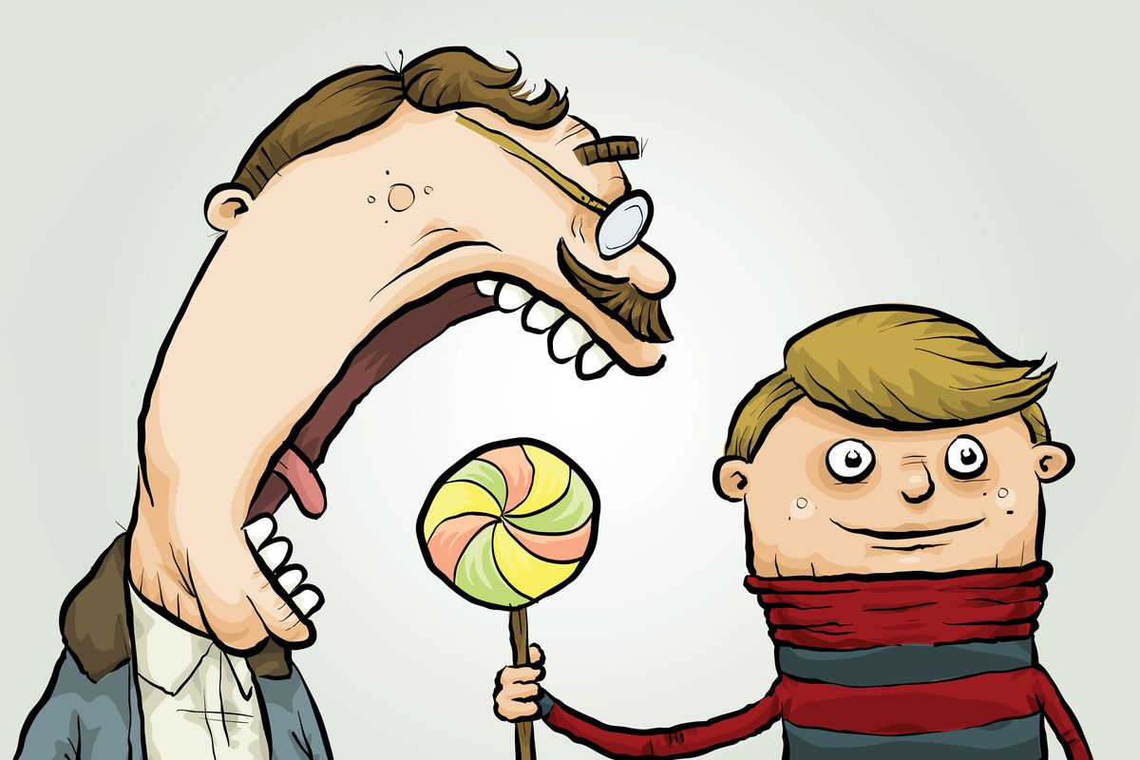
Self-control the standard view
Self-control and goal progress
  Trait and State Self-control helps people to meet their goals
Definition of self-control
  Self-control most often equated with willpower: inhibition, self-restraint or self-stopping

Slide 6
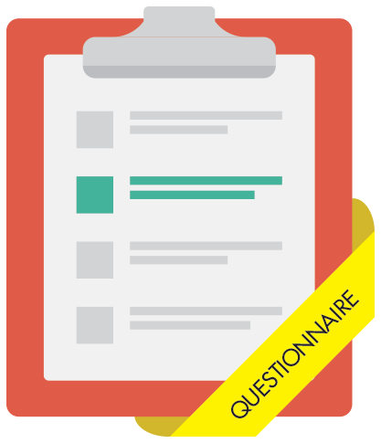
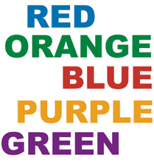
How we measure self-control now
The measure of self-control dominated by retrospective self-report and cognitive reaction-time measures
  Conscientiousness (Big-5), grit, self-control scale
  Stroop, go/no-go, stop signal task, flanker task
Critiques:
  These assess trait-level self-control (self-report)
  Might suffer from retrospective biases
  Artificial lab tests that have no bearing on real world
    Is colour-naming really associated with how well I stick to my diet?

Slide 7
Rethinking measurement of Self-Control
  Methods: N=2,641
Self-Control
I get distracted easily
I say inappropriate things
Grit
My interests change every year
New ideas distract me
Conscientiousness
I do things spur of the moment
I cancel plans at the last minute
Saunders, Milyavskaya, Etz, Randles, & Inzlicht, 2018
Notes:
- Jingle-jangle fallacies refer to the erroneous assumptions that two different things are the same because they bear the same name (jingle fallacy) or that two identical things are different because they are labeled differently (jangle fallacy)
-Grit: Effortfully persevering to achieve long-term goals despite setbacks
- Consciousness: Personality trait related to being careful or vigilant; relates to a desire to do a task well; critically it relates to self-discipline and self-control

Slide 8
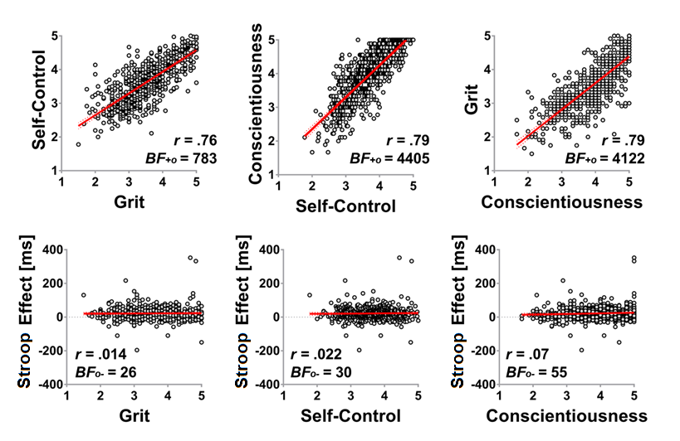
(Grit=Consc=Self-Control) ≠ effortful inhibition
Small or negligible relationship with Stroop!
Why? 2 possibilities
  Conscientiousness does not measure inhibitory control
  Conscientiousness is many things, not just inhibition
Saunders, Milyavskaya, Etz, Randles, & Inzlicht, 2018

Slide 9
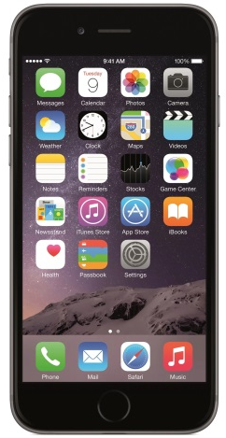
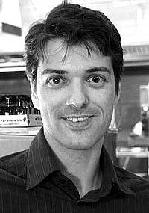
Rethinking: how to measure self-control
EXPERIENCE SAMPLING (Hofmann, baumesiter, forster, vohs, 2012)
  Benefits: real-time self-control, personally meaningful domains, limited retrospective bias, can examine within-person variation
Ask participants their desires in the moment by texting them 7 times a day for 7 days to ask what they are thinking about
  Are you desiring something now?
  If yes, what do you desire?
    food, nonalcoholic drinks, alcohol, coffee, tobacco, other substances, sex, media, spending, work, social, leisure, sleep, hygiene-related
  How strong is the desire?
  Does the desire conflict with personal goals? (temptation)
  Did you try resisting the desire? (control)
  Did you enact the desire?
Wilhelm Hofmann

Slide 10
Hofmann et al., 2012
New way to examine self-control, with major strength being its in real world
  Desire predicts enactment of desire
  With temptation, self-control is recruited, which predicts less enactment of (tempting) desire

Slide 11
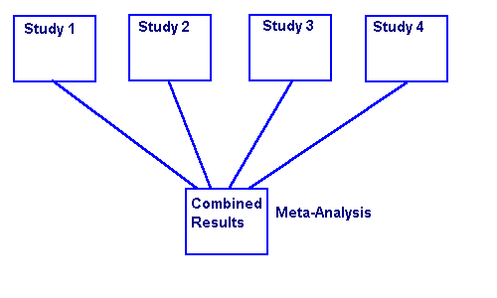
Rethinking: Trait self-control I
People with high self-control, control themselves more, right?
De Ridder meta-analysis of trait self-control (2012)
  Meta-analysis of 102 studies (n=32,648) measuring trait self-control (self-report)
Moffitt et al., 2011

Slide 12

De Ridder meta-analysis, 2012
Controlled behaviour
  Requiring conscious attention & deliberation (e.g., quitting smoking)
Automatic Behaviour
  Behaviours performed unintentionally, without awareness or control (e.g., habitual smoking)
Those high in self-control might be better at forming (effortless) habits
  Not necessarily better at resisting temptation or self-denial

Slide 13
Rethinking: Trait self-control II
Hofmann et al., 2012
People high in trait self-control engage in less effortful self-control!
They experience fewer conflicts/temptations to begin with, so don’t need to control as much
  But effect holds when controlling for frequency of conflict

Slide 14


Rethinking: control & fatigue
Milyavskaya & inzlicht, 2017
September
In-lab questionnaire
October
Smart-phone
December
Online questionnaire
4 Goals (e.g., learn French, lose 2kgs)
Momentary (5 daily)
-Desire (Y/N, strength)
-Conflict
-Effortful self-control
-Depletion/fatigue
Goal progress

Slide 15
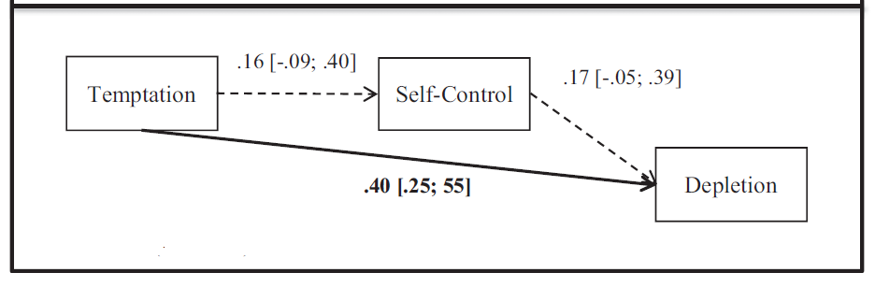
Control not always related to fatigue temptation consistently related to fatigue
Milyavskaya & Inzlicht, 2017
Standard view is that resisting temptation is tiring
  Simply experiencing temptation is enough
  Why?
Wilkowski et al., 2018

Slide 16
Break time

Slide 17



Yes Trait self-control is important
Trait self-control & short-term outcomes
Sample 1, N=159; Sample 2, N=226
Baseline
In-lab Qs
In the Wild
Smart-phone
+1 month
Online Qs
+3 months
Online Qs
+6 months
Online Qs
Self-control Scale
4 Goals (e.g., Learn French, lose 10lbs)
Goal progress
Goal progress
Goal progress
Saunders, Milyavskaya, & Inzlicht, 2022
Notes:
For seven days, five times during the day at random from 10am to 10pm, participants received a text message with a link to a brief online survey regarding their present experience, which they were asked to complete immediately
In the experience sampling survey, participants were first asked about whether they were currently experiencing a desire or had experienced one in the past 30 minutes. Only those surveys on which a current or recent desire was reported were analysed
self-control at the observation level was based on one item asking participants whether they tried to resist or control the desire on a scale of -3 (did not try to resist at all) to 3 (tried very hard to resist).
depletion was assessed during the experience sampling with one item: “How mentally exhausted are you in the moment?”, rated on a scale of 0 (not at all) to 6 (very much).
Goal progress was assessed at the end of the semester using three items for each goal: “I have made a lot of progress toward this goal”, “I feel like I am on track with my goal plan”, and “I feel like I have achieved this goal”.

Slide 18
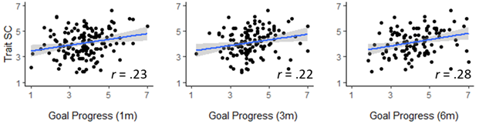
Trait self-control & goal progress
Saunders, Milyavskaya, & Inzlicht, 2022

Slide 19
Rethinking: effectiveness of control
does state self-control lead to goal-progress?
September
In-lab questionnaire
October
Smart-phone
December
Online questionnaire
4 Goals (e.g., learn French, lose 2kgs)
Momentary (5 daily)
-Desire (Y/N, strength)
-Conflict
-Effortful self-control
-Depletion/fatigue
Goal progress

Slide 20

Rethinking: effectiveness of control control does not predict reaching goals!
-.09 [-.20; .02]
BF₀₁ = 23.51
Temptation
Self-control
-.01 [-.12; .11]
Marina Milyavskaya
Goal Attainment
-.50** [-.98;-.02]
experiencing tempting desires predicts (not) reaching goals
Why?
  Do successful people actually encounter fewer temptations?
  Or do they construe the same tempting desires as less tempting?

Slide 21
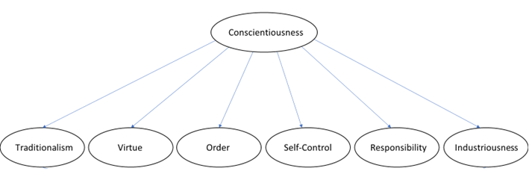
Trait Self-control: measure of broad ability
Self-control scale does not assess restraint
But assesses:
  Being neat & orderly
  Willingness to exert effort
  Making plans
  Acting prosocially
  Being responsible
  Meaning derived from effort

Slide 22
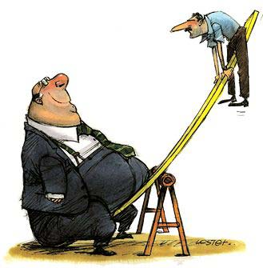
does self-control help with goals?
Yes for trait self-control
  Self-controlled people experience numerous desirable long term outcomes
BUT:
  Self-controlled people restrain themselves less in the moment
  Their success accrues in other ways
    They are less tempted to begin with
    Make plans; are orderly; enjoy effort
No for state self-control in the long term
  Momentary restraint does not predict long-term success
Unvirtuous
Desires
Weak Control

Slide 23

Rethinking inhibition
What is inhibition?
Tell me: HOW have you inhibited your desires in the past?
Inhibition is not a process; it is a goal (Werner et al., 2022)

Slide 24
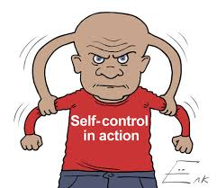

Rethinking: the definition of self-control
Duckworth, Gendler, & Gross, 2016
Why is self-control most often equated with self-stopping and inhibition?
There are multiple ways to control or modify behaviour so that it’s in line with goals
  Reactive (inhibitory) control just one way
  Proactive control also important
Angela Duckworth

Slide 25
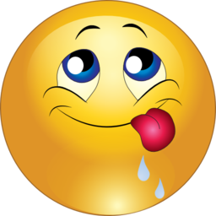
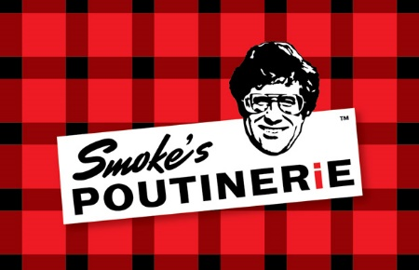
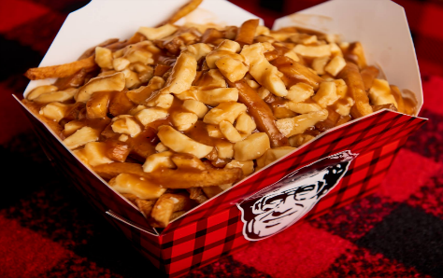
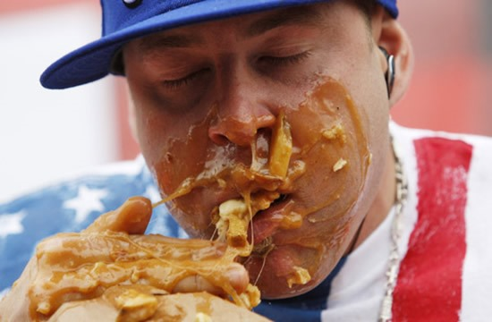
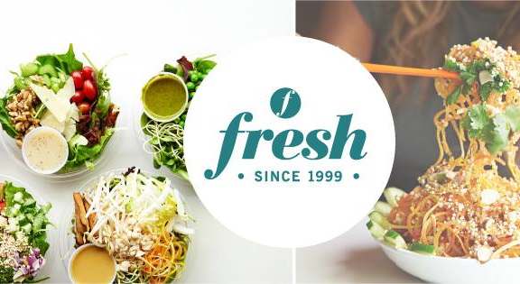
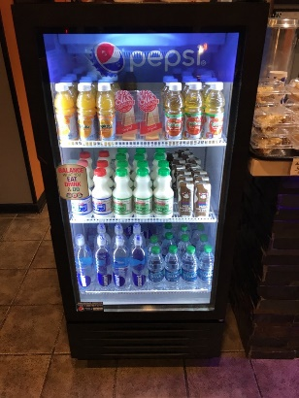
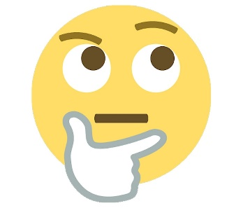
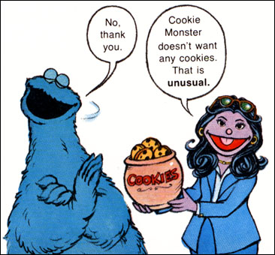
Rethinking: the definition of self-control
It’s not all about inhibition
Situation
Appraisal
Response
Attention

Slide 26

Alternatives to inhibition
Situation
  Situation selection: switch environments!
  Situation modification: modify environment
Attention
  Attentional deployment: focus on something else; distraction
Appraisal
  Reappraise: change the way you think of tempting object

Slide 27
How do people resist their desires?
Strategy to Resist Desires | %
Removal from Situation | 10%
Distraction | 20%
Goal Reminder | 29%
Promise to give in later | 27%
Reminder of why it was bad for me | 17%
Willpower/simply resisted | 21%
Other | 5%
None | 11%
More than 1 Strategy | 26%
Situation Selection 9%
Milyavskaya, Saunders, & Inzlicht, 2021

Slide 28
strategies works…in the moment

